Slide 1
Chapter 7: Data defining Language
2023

Slide 2
Chapter 7: Data defining Language
Content:
Create database
Use Clause
Create tables
Insert into
Drop Table/Database
Truncate table

Slide 3
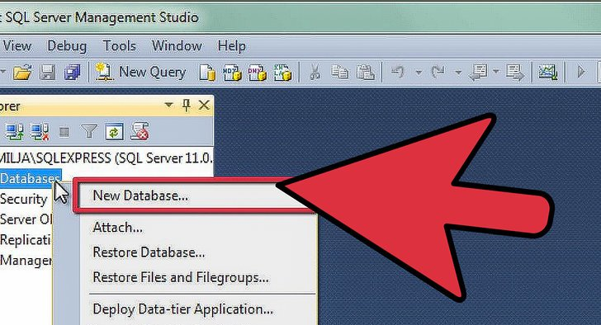
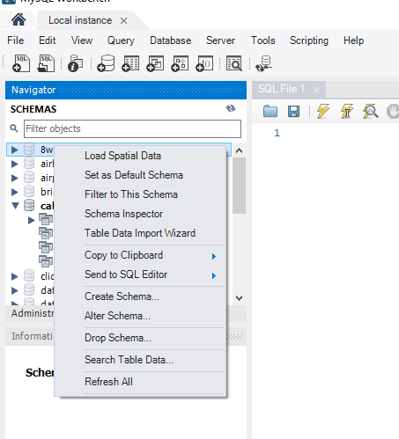
create Database
SQL Server
MySQL
CREATE DATABASE databasename;
CREATE DATABASE testDB;
Notes:
Naming – Preferably no space in names – will work but difficult to manage later
https://www.universalclass.com/articles/computers/sql/how-to-create-alter-rename-and-drop-tables-in-sql.htm

Slide 4
Use
USE DatabaseName;
USE testDB;
Notes:
The USE Statement is used to select a database and perform SQL operations into that database.
The database remains default until end of session or execution of another USE statement with some other database.
Before USE you can do:
SHOW DATABASES;
Then specify the one you d like to USE

Slide 5
Create table
Create table tablename
(columnName datatype ,
ColumnName datatype);
CREATE TABLE Persons ( PersonID int, LastName varchar(255), FirstName varchar(255), Address varchar(255), City varchar(255), );

Slide 6
Create table
Create table cats
(
CatID int not null auto_increment ,
Name varchar(20) NOT NULL,
age int NOT NULL ,
dob date default getdate() ,
primary key(catID)
)
OR
Create table cats
(
CatID int not null auto_increment Primary key,
Name varchar(20) NOT NULL ,
age int NOT NULL ,
dob date default getdate()
)
Notes:
‘no commas needed if more than one datatype
(for MySQL Syntax)
OR
Create table cats
(CatID int not null auto_increment Primary key
Name varchar(20) NOT NULL
age int NOT NULL
dob date default getdate())
( Syntax for SQL Server)
CREATE TABLE Persons ( Personid int IDENTITY(1,1) PRIMARY KEY, LastName varchar(255) NOT NULL, FirstName varchar(255), Age int );
Show tables
Show columns from database
Desc tblName
Data type - DOB
Curdate / getdate() ??
→ PK in wrong place??

Slide 7
CREATE TABLE CUSTOMERS
(
ID INT NOT NULL,
NAME VARCHAR (20) NOT NULL,
AGE INT NOT NULL ,
ADDRESS CHAR (25) ,
SALARY DECIMAL (18 , 2),
PRIMARY KEY (ID)
);
Notes:
For instance, decimal (4,2) indicates that the number will have 2 digits before the decimal point and 2 digits after the decimal point

Slide 8
Insert into
Once your table is created you need to add data to it. This is how we do that:
INSERT INTO table_name (column1 , column2, column3 ,...) VALUES (‘value1’ , ’value2’ , ’value3’ ...);
INSERT INTO students (first_name, last_name , email , phone , birthdate)
VALUES ("Peter" , "Rabbit" , "peter@rabbit.com" ,"555-6666" , "2002-06-24");
INSERT INTO students (first_name, last_name , email , phone, birthdate)
VALUES ("Alice" , "Wonderland" ,"alice@wonderland.com" ,"555-4444" , "2002-07-04");
Notes:
More than 1 record:
INSERT INTO employees (employee_id, last_name , first_name)
VALUES (10,‘Anderson’,‘Sarah’) ,
(11,‘Johnson’,‘Dale’);

Slide 9
More than 1 record:
INSERT INTO employees (employee_id, last_name , first_name)
VALUES (10,‘Anderson’,‘Sarah’) , (11,‘Johnson’,‘Dale’);

Slide 10
insert into
(1)
INSERT INTO table_name (column1 column2 column3 ...) VALUES (‘value1’, ’value2’ , ’value3’ ...);
(2)
INSERT INTO table_name VALUES (‘value1’, ‘value2’, ‘value3’ ...);
INSERT INTO Customers (CustomerName, ContactName, Address, City , PostalCode, Country) VALUES ( ‘Cardinal’, ’ Tom B. Erichsen’, ‘Skagen 21’ , ‘Stavanger’ , ‘4006’ , ‘Norway’ );
INSERT INTO Customers (CustomerName , City ,Country) VALUES ( ‘Cardinal’ , ‘Stavanger’, ‘Norway’ );
Notes:
The INSERT INTO statement is used to insert new records in a table
It is possible to write the INSERT INTO statement in two ways.
The first way specifies both the column names and the values to be inserted
If you are adding values for all the columns of the table you do not need to specify the column names in the SQL query. However make sure the order of the values is in the same order as the columns in the table.
https://www.universalclass.com/articles/computers/sql/using-the-insert-statement-in-sql.htm

Slide 11
INSERT INTO Employees
(LastName , FirstName , Title , TitleOfCourtesy, BirthDate, HireDate , Address ,City Region , PostalCode , Country , HomePhone, Extension)
VALUES ( ‘Dunn’, ‘Nat’ , ‘Sales Representative’, ‘Mr.’, ‘1970-02-19’, ‘2004-01-15’, 4933, ‘Jamesville Rd.’ , ‘Jamesville’ , ‘NY’ , 13078 , ‘USA’ , ‘315-555-5555’, 130 );
Notes:
Insert new Employee

Slide 12
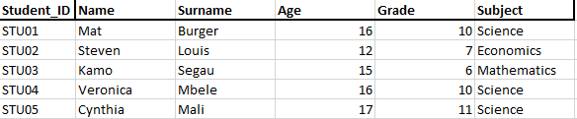
Create / insert
Create a Database called StudentsDb
Create a table “Students_tbl” in your database with suitable data types that will take the following student credentials: Student_ID(5) Name(20) Surname(20) , Age , Grade , Subject(20)
Add the following students and their credentials to the above created table:
Notes:
create database studentsDB;
use studentsDB;
create table Students_tbl (Student_ID varchar(5), name varchar (20), surname varchar(20), age int, grade int, subject varchar(20));
insert into students_tbl (Student_ID, name , surname , age , grade , subject)
values ('Stu01','Mat','Burger',16,10,'Science'),('Stu02','Steven','Louis',12,7,'Economics’);
select * from students_tbl;

Slide 13
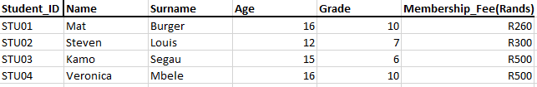
Create / insert
A school hockey club has been created “Wild Cats” and you are the administrator of the table for students enrolled in the club. The table should be created in the StudentsDb.
Create a table for “Wild_Cats” in your database with suitable data types that will take the following student credentials: Student_ID(5) , Membership_Fee(10)
Add the following students and their credentials to the above created table:

Slide 14
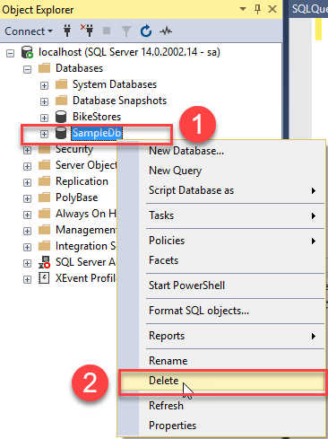
Drop Database
DROP DATABASE databasename;
DROP DATABASE testDB;
Notes:
Deleting a database will result in loss of complete information stored in the database

Slide 15
Drop table
DROP TABLE table_name;
DROP TABLE Shippers;
Notes:
The SQL DROP TABLE statement is used to remove a table definition and all the data indexes triggers constraints and permission specifications for that table.
NOTE − You should be very careful while using this command because once a table is deleted then all the information available in that table will also be lost forever.

Slide 16
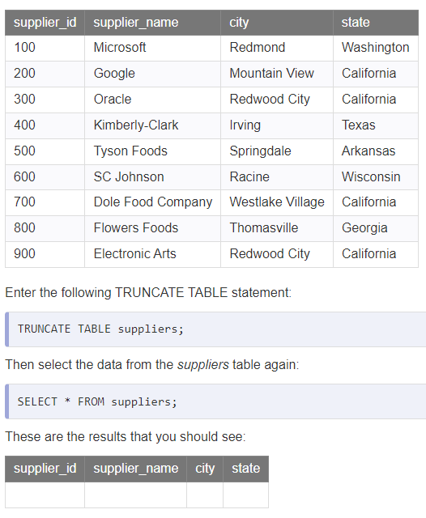
Truncate
TRUNCATE TABLE table_name;
Notes:
The TRUNCATE TABLE statement is used to delete the data inside a table but not the table itself.

